Slide 1



Trauma-affected students
By the time they reach college, 66 to 85 percent of youth report lifetime traumatic event exposure
(Read et al., 2011; Smyth et al., 2008)
Sixty percent of adults have reported experiencing abuse or other difficult family circumstances during childhood
(National Center for Mental Health Promotion and Youth Violence Prevention, 2012) .
Individuals who have experienced childhood trauma are also more likely to have a history of chronic absenteeism, behavioral issues, grade repetition, or placement in special education (Shonk & Cicchetti, 2001)
Notes:
TI Teaching: Trauma Affected Students
Level: Beginner/Intermediate/Clinical
These stats were used in “Introduction” Section as well.
Discussion:
So much of the general population we interact with have experienced trauma in some capacity, and these statistics are look just into our student population.
How do you think these statistics affect access and decisions to attend post-secondary education?
Sources:
Education Northwest | Trauma-Informed Practices for Postsecondary Education: A Guide
National Center for Mental Health Promotion and Youth Violence Prevention . (2012) . Childhood trauma and its effect on healthy development. Retrieved from Education Development Center website: http://www.promoteprevent.org/content/childhood-trauma-and-its-effect-healthy-development
Read, J . P ., Ouimette, P ., White, J ., Colder, C ., & Farrow, S . (2011) . Rates of DSM–IV–TR trauma exposure and posttraumatic stress disorder among newly matriculated college students . Psychological Trauma: Theory, Research, Practice, and Policy, 3(2), 148–156 .
Shonk, S. M., & Cicchetti, D. (2001). Maltreatment, competency deficits, and risk for academic and behavioral maladjustment. Developmental Psychology, 37(1), 3–17
Smyth, J. M., Hockemeyer, J. R., Heron, K. E., Wonderlich, S. A., & Pennebaker, J. W. (2008). Prevalence, type, disclosure, and severity of adverse life events in college students. Journal of American College Health, 57(1), 69-76.​

Slide 2

Trauma-Informed Teaching
COVID-19
(USDA, n.d.)
Notes:
TI Teaching: COVID-19
Level: Beginner/Intermediate/Clinical
Discussion:
How does a global pandemic fit with all of this? ​
Now, let’s talk briefly about COVID. How many of you were feeling tired, stretched thin, maybe even burned out before COVID? How are you feeling now?
With certainty, we’ve all been experiencing what can be considered a collective trauma. Many of us lost loved ones, became isolated physically, socially, emotionally, maybe even became ill ourselves which may have created a whole different kind of stress. Add to this our already existing feelings from before of being tired and burned out, and COVID created a perfect storm of at least significant stress if not collective trauma for faculty, staff and students. We weren’t in a good place to begin with.​ It almost created a paralyzing sensation - and a constant grief process - grieving the loss of life events.​
While COVID was a shared collective trauma and communication with students about changes were higher, As instructors, we often carry heavy burdens that we don’t want to share with students.​ Students experience their own heavy burdens they don’t necessarily want to share with us…
We also had students drop from their programs at a rate I hadn’t seen before. Students had to make choices between caring for family or staying in school. Students had to make choices about continuing to work or stay in school. The pressures between were too much for them.​
​From a study of 70 higher education institutions in 2021, we know:
Prior to Delta and Omicron outbreaks, Nearly 1/3 of students indicated a family member or close friend was hospitalized due to COVID and 13% had lost a family member or close friend to COVID 19. (Correia-Harker, 2022)
Prior to Delta and Omicron outbreaks, More than 1/3 of all students lost wages from employment, with even higher percentages of students losing wages in “working class” and “low-income” student groups. (Correia-Harker, 2022)
Over half of working class and low income students were concerned or very concerned about their ability to pay for education in the future. (Correia-Harker, 2022)
Sources
Carreia-Harker, B. P. (2022, Jan 21). MSL 2021 Snapshot: Exploring the Effects of the Pandemic on College Students. Multi-Institutional Study of Leadership. https://www.leadershipstudy.net/leadershipthoughts/2022/1/21/msl-2021-snapshot-exploring-the-effects-of-the-pandemic-on-college-students
U.S. Department of Agriculture [USDA]. (n.d.) Coronavirus Disease (COVID-19). https://www.usda.gov/coronavirus

Slide 3
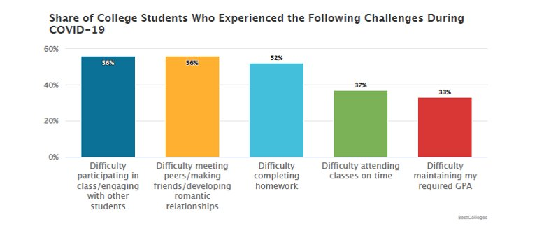

(Best Colleges, 2022)
Notes:
TI Teaching: COVID-19
Level: Beginner/Intermediate/Clinical
Discussion:
For those students that stayed throughout the Pandemic, Some of the most apparent challenges that were found in this study are listed here. ​
Difficulty participating in class or engaging with other students. I experienced this especially in my in-person classes. By Fall mid-semester, I had around 50% of the students attending in person. ​(BestColleges, 2022)
Difficulty meeting peers – I had whole cohorts of students who had never met their classmates in person until last fall. That’s powerful.​ ​(BestColleges, 2022)
Difficulty completing homework – we’ll circle back to this during strategies.​ ​(BestColleges, 2022)
Difficulty attending classes on time and difficulty keeping grades up. All experiences I’ve had with my classes.​ ​(BestColleges, 2022)
Sources:
Best Colleges. (2022, July 20). Over 9 in 10 College Students Report Mental Health Impacts From COVID-19. Best Colleges. https://www.bestcolleges.com/research/college-mental-health-impacts-from-covid-19/

Slide 4
Trauma-Informed Teaching
What about the students who:
We don’t know are struggling?
Don’t approach us for help?
Have something going on beyond COVID?
COVID-19
Notes:
TI Teaching: COVID-19 wrap up
Level: Beginner/Intermediate/Clinical
Discussion
Remember when I shared about students who dropped the program? Those were students who came to me, we tried to create a mediation plan, and it still didn’t work.
However, what about those students who never approach us, never let us know they’re struggling, who we might see in class and feel like they are just quiet or uninterested in the topic? Or maybe they’re snarky and argumentative?
We may draw conclusions about students that really only reflect a surface level observation.
When I talk about kid behavior, I always say that big behaviors are a message for something else. Anger is sometimes masking disappointment or sadness. It’s often the same in adults. Sometimes, we only see the surface level, but what we don’t see, under the surface is so much more significant to help us understand how best to support.

Slide 5
THE LENS
Make mental health part of the conversation​
I can’t do anything about it…
I’ll leave it to the experts
Learn about strategies to implement​
Embrace the challenge!
Notes:
TI Teaching: Our Role
Level: Beginner/Intermediate/Clinical
Discussion
So, what can we do about all of these challenges? I am not the expert- I just know some things about trauma. Just like I am not an expert, you aren’t expected to be either.
We all need to be informed about trauma so that we can create our own best practice strategies to support each other and our students.
Sources
Sourced from: Williams-Hecksel, C., Miller, D., & Fritz, T. (n.d.). Building Trauma-Informed Learning Environments.

Slide 6

What does trauma look like in students?
Challenges with emotional regulation
Fear of taking risks
Difficulty focusing, attending, retaining, and recalling
Tendency to miss a lot of classes
Anxiety about deadlines, exams, group work, or public speaking
Withdrawal and isolation/Involvement in unhealthy relationships
Anger, helplessness, or dissociation when stressed
Triggers/Reminders
Watching for threats
Hypervigilance
Feeling unsafe
Processing an event
(Hoch et al., 2015)
Notes:
TI Teaching: What does trauma look like in students?
Level: Beginner/Intermediate/Clinical
Discussion:
Processing prolonged stress and trauma can be physically and emotionally demanding and time consuming (Brewin, 2003; Foa & Kozak, 1986)
Normal goals and obligations may be suspended, at least temporarily, while the individual devotes time and energy to processing and working through the traumatic experience (Bonanno, Pat-Horenczyk, & Noll, 2011).
they spend a lot of their energy scanning their environment for threats; their bodies act as if they are in a constant state of alarm; their brains are endlessly vigilant; and they may experience a constant baseline feeling of low-level fear, which leaves less space for curiosity, exploration, and learning (Hoch et al., 2015)
Sources
Bonanno, G. A., Pat-Horenczyk, R., & Noll, J. (2011). Coping flexibility and trauma: The Perceived Ability to Cope With Trauma (PACT) scale. Psychological Trauma: Theory, Research, Practice, and Policy, 3(2), 117–129
Brewin, C. R. (2003). Posttraumatic stress disorder: Malady or myth? New Haven, CT: Yale University Press.
Foa, E. B., & Kozak, M. J. (1986). Emotional processing of fear: Exposure to corrective information. Psychological Bulletin, 99(1), 20–35
Hoch, A., Stewart, D., Webb, K., & Wyandt-Hiebert, M. A. (2015, May). Trauma-informed care on a college campus. Presentation at the annual meeting of the American College Health Association, Orlando, FL.

Slide 7
Trauma Informed Teaching
Common challenges
How do I know my students are going through something and not being lazy?
I want to talk about potentially triggering topics or content that are relevant and important, but I don't know how or if it is OK.
How do I maintain appropriate boundaries when taking on a trauma-informed approach?
How do I establish a trauma-informed approach while instructing students in fieldwork/clinical experience?
How do I adopt a trauma-informed lens while keeping expectations/rigor of my course?
Notes:
TI Teaching: Common Questions and Challenges
Level: Beginner/Intermediate/Clinical
Discussion
When learning about trauma informed teaching, we are often asked the following questions. These questions come from across disciplines.
How do I know my students are going through something and not being lazy?
Further, how do I adopt a trauma-informed lens while keeping expectations/rigor of my course?
I want to talk about potentially triggering topics or content that are relevant and important, but I don't know how or if it is OK.
How do I maintain appropriate boundaries when taking on a trauma-informed approach?
How do I establish a trauma-informed approach while instructing students in fieldwork/clinical experience?
You don’t have to throw out how you teach for the sake of being trauma informed.
We hope that today’s discussion answers some of these questions, but ongoing conversation and personal values will absolutely impact how you implement being trauma informed into your teaching.

Slide 8
Trauma Informed Teaching
Best Practices
Empower students
Express unconditional positive regard
Maintain high expectations
Check assumptions, observe, and question
While using restorative practices over zero-tolerance policies​
Avoid romanticizing trauma narratives in subject content
Check in with students
Provide guided opportunities for helpful participation
Notes:
​TI Teaching: Classroom Best Practices 1
Level: Beginner/Intermediate/Clinical
Discussion
The following are some strategies for trauma-informed teaching across disciplines, according to Carello and Butler (2014); Downey (2013); Health Federation of Philadelphia (2010); and Wolpow, Johnson, Hertel, and Kincaid (2009):
Always empower students. By offering choices for participation and encouraging their sense of agency, educators help students feel some control over their lives. In addition, when students make positive choices and educators praise them for doing so, they begin forging a positive direction in their own lives. Trauma-informed educators avoid struggles with students; classroom discipline is necessary, but it should be done in a way that is respectful, consistent, and nonviolent. Students who have experienced trauma often seek to control their environment to protect themselves, and their behavior will generally deteriorate the more helpless they feel.
Express unconditional positive regard. Trauma-informed educators, as consistently caring adults, have the opportunity to help students build trust and form relationships. Even if a student acts out and expresses hatred for or cruel judgments of the educator, the response must always be unconditional positive regard: “I’m sorry you feel that way. I care about you and hope you’ll get your work done.”
Maintain high expectations. Trauma-informed educators set and enforce limits in a consistent way that provides high expectations for all students. Maintaining consistent expectations, limits, and routines sends the message that the student is worthy of continued unconditional positive regard and attention. In addition, consistency in the classroom helps students differentiate between the arbitrary rules that led to their abuse and the purposeful ones that assure their safety and well-being. trauma-informed educators maintain a consistent schedule and classroom structure, model flexibility when faced with unexpected changes to their routine.
Use restorative practices over zero-tolerance policies​
zero-tolerance policies are ineffective and harmful. Zero-tolerance policies focus on the offense and are rooted in punishment.
Kids are punished for committing an infraction with detention, suspension, or expulsion. It removes the student from the classroom environment but does not consider the student as an individual and what might have led to the misbehavior. Zero-tolerance policies disproportionately affect students of color, perpetuate the school-to-prison pipeline, and do not provide the support or services the struggling student needs to achieve.​
Rather than a single technique or tactic, restorative justice is a paradigm shift in how schools consider discipline and how students who break the rules are perceived and addressed. The goal is to create a new disciplinary system that is highly supportive while also being highly controlled. This system is rooted in respect, healing, empathy, and accountability. Restorative practices seek to do just that – restore relationships and environments. Instead of focusing on punishing the offending student, the focus shifts to repairing relationships between the offending student and the victim or repairing physical damage that may have occurred.​
Restorative practices use support systems, including talking circles and peer juries, to create an environment where the student can hear how their actions affected the other party, and the offending student can respond. This approach humanizes both parties and encourages keeping the misbehaving student in the fold rather than excluding them from the school community. It also allows the student to be involved in finding a way to make amends instead of having a punishment doled out upon them. Restorative practices rebuild a traumatized student’s relationships with authority figures, reform their belief in fairness, and build their capacity for conducting themselves with integrity.​
Research shows that school-wide use of restorative practices has long-term, positive impacts on student behavior, attendance, and achievement. Drop-out and truancy rates decline, and students report being happier while in school. Utilizing this trauma-informed positive behavior support can create an entirely different school environment, especially for students affected by trauma.​
​
Check assumptions, observe, and question. Trauma informed educators talk to students and ask questions instead of making assumptions, as trauma can affect any student and manifest in many ways. Trauma-informed educators also make observations to students about their behaviors and then fully engage in listening to the response.
Avoid romanticizing trauma narratives in subject content. Although some individuals experience post-traumatic growth after successfully adapting to the fallout of traumatic experiences, ensure your lesson content or subject matter does not depict trauma as romantic or desirable
Check in with students. Identify learning as the primary goal—and students’ emotional safety as a necessary condition for it. Educators should never underestimate the impact of sincerely asking a student, “What’s going on?” This simple question can open up a dialogue and provide information educators need to better understand and meet students’ needs. Along those lines, asking this question lets students know their teachers and the community care about them.
Provide guided opportunities for helpful participation. Trauma-informed educators model, foster, and support ongoing peer “helping” interactions, such as peer tutoring and support groups, to provide traumatized students with the opportunity to practice academic and social-emotional skills. Trauma-informed educators assist traumatized students of all ages in developing social skills and help them cultivate positive relationships. Connect students to peers or other adults who can provide them with additional support. Be prepared to refer students to your institution’s counseling services or emergency care if needed.
Sources:
Carello, J., & Butler, L. D. (2014). Potentially perilous pedagogies: Teaching trauma is not the same as trauma-informed teaching. Journal of Trauma & Dissociation, 15(2), 153–168
Downey, L. (2013). Calmer classrooms: A guide to working with traumatised children. Melbourne, Victoria, Australia: State of Victoria, Child Safety Commissioner, & Queensland, Australia: State of Queensland, Department of Education, Training and Employment.
Health Federation of Philadelphia, Multiplying Connections. (2010). CAPPD: Practical interventions to help children affected by trauma. Retrieved from http://www.multiplyingconnections.org/become-trauma-informed/cappd-interventions-guide
Wolpow, R., Johnson, M. M., Hertel, R., & Kincaid, S. O. (2009). The heart of learning and teaching: Compassion, resiliency, and academic success. Retrieved from Office of Superintendent of Public Instruction, Compassionate Schools website: http://www.k12. wa.us/compassionateschools/pubdocs/TheHeartofLearningandTeaching.pdf

Slide 9
Trauma Informed ​Best Practices for the Classroom
Recognize the signs​
Structure and clarity​
Social emotional support​
Restorative practices over zero-tolerance​
Pedagogy​
Self-care
Notes:
TI Teaching: Classroom Best Practices 2A
Level: Beginner/Intermediate/Clinical
Discussion
Recognize the signs of trauma​
difficulty focusing, ​
struggling with creating and maintaining friendships, ​
being overly tired, and/or having poor self-regulation. ​
Excessive absences, ​
changes in their school performance, and ​
withdrawing from activities or others may also be signs that a person has been affected by trauma.​
​
Provide consistency and structure​
Predictable schedules, structure and integration of elements of academics, with entertainment or play, and physical exercise or movement. ​
Consider including aspects of self-regulation – this is skill building and can be a supprot for focusing and a part of structure. (Breathing exercises, mindfulness, journaling can be helpful) ​
Consistency is key to security.​
Communicate - overview each day, review lessons (past, current and future) Doing this up front can reduce anxiety for those who may become easily distracted, wondering or fearing what might come next. This quick and straightforward task may help return a bit of control to the individual and support their preparation for participation and engagement. ​
Virtual settings - Consider setting expectations and goals together as a class, define responsibilities, and regularly checking in with virtual students to see how they are faring.​
​
Utilize social-emotional learning and supports​
Social-emotional learning, also called SEL, is the process through which students develop skills in critical areas. These areas include self-awareness, self-control, social awareness, interpersonal skills such as feeling and demonstrating empathy for others, effective listening and communication, and making responsible decisions. SEL skills are critical for success in school, life, and work.​
Educators can teach these skills in various ways, including modeling behavior, using specially designed SEL curriculum materials, and in their classroom management practices. In addition to specific counseling activities to teach social-emotional learning, these skills can often be introduced in the midst of everyday learning:​
When reading a story to the class, discuss how characters might think or feel.​
Assigning responsibilities and tasks to each student builds a sense of self-worth.​
Starting the day with an affirmation can set the tone for a positive learning environment as it encourages positive self-talk and promotes a growth mindset.​
Teaching mindfulness activities such as breathing can be done in conjunction with “brain breaks” in between lessons.​
Journal exercises help students identify and express their feelings or opinions, and group discussions can promote healthy and respectful disagreements.​
Social-Emotional Learning Circles help promote community discussions and respectful, reflective listening.​
​
Use restorative practices over zero-tolerance policies​
zero-tolerance policies are ineffective and harmful. Zero-tolerance policies focus on the offense and are rooted in punishment.
Kids are punished for committing an infraction with detention, suspension, or expulsion. It removes the student from the classroom environment but does not consider the student as an individual and what might have led to the misbehavior. Zero-tolerance policies disproportionately affect students of color, perpetuate the school-to-prison pipeline, and do not provide the support or services the struggling student needs to achieve.​
​
Rather than a single technique or tactic, restorative justice is a paradigm shift in how schools consider discipline and how students who break the rules are perceived and addressed. The goal is to create a new disciplinary system that is highly supportive while also being highly controlled. This system is rooted in respect, healing, empathy, and accountability. Restorative practices seek to do just that – restore relationships and environments. Instead of focusing on punishing the offending student, the focus shifts to repairing relationships between the offending student and the victim or repairing physical damage that may have occurred.​
​
Restorative practices use support systems, including talking circles and peer juries, to create an environment where the student can hear how their actions affected the other party, and the offending student can respond. This approach humanizes both parties and encourages keeping the misbehaving student in the fold rather than excluding them from the school community. It also allows the student to be involved in finding a way to make amends instead of having a punishment doled out upon them. Restorative practices rebuild a traumatized student’s relationships with authority figures, reform their belief in fairness, and build their capacity for conducting themselves with integrity.​
Research shows that school-wide use of restorative practices has long-term, positive impacts on student behavior, attendance, and achievement. Drop-out and truancy rates decline, and students report being happier while in school. Utilizing this trauma-informed positive behavior support can create an entirely different school environment, especially for students affected by trauma.​
​
Implement a trauma-informed pedagogy​
Trauma-informed pedagogy is the practice that keeps trauma and how it affects learners at the forefront when designing and implementing teaching strategies. For instance, during this time of uncertainty and social isolation with the COVID 19 pandemic, educators can recognize that these stressors may compound upon existing trauma and lead to students having a more challenging time completing even basic tasks, being motivated, and engaging with other students.​
Provide content warnings before discussing potentially triggering topics. ​
The educator also prepares themselves in advance on how to respond if a student is triggered. ​
allows students to opt-out of participating in these discussions and reassures students that they can opt-out without any penalties. ​
describes and teaches grounding techniques for students who may feel overwhelmed. ​
​
These types of practices help to create a safe and supportive learning environment for all students.​
​
Self Care – next slide​
​
Sources:

Slide 10
Trauma Informed ​Best Practices for the Classroom
Self Care
Reflective Practice
Mindfulness
Emotion Regulation Skills
Supervision & support
Learning
Notes:
​TI Teaching: Classroom Best Practices Self Care 1B
Level: Beginner/Intermediate/Clinical
Discussion
Self-care while being trauma-informed​
In order to create a supportive, trauma-informed classroom, it is imperative that instructors not only identify and deal with their own trauma but also regularly engage in self-care. Self-care techniques can vary based on the educator’s preferences, but examples include exercise, traveling, reading, meditation, yoga, seeing a therapist, and participating in creative or artistic pursuits, such as dancing or painting.​
​
Effective strategies to manage trauma related stress​
Self-care​
Reflective practice​
Mindfulness​
Emotion regulation skills​
Supervision and supervisory support (how therapists use clinical supervision)​
Learning – like today – what else keeps you learning? How do you gain mastery?

Slide 11
Working with trauma-affected students
What you can do
Help students feel seen and respected
Connect students to the school community
Provide students with opportunities to practice their skills
Embrace teamwork and shared leadership
Anticipate and adapt to the changing needs of students and the community
Notes:
TI Teaching: Working with trauma-affected students
Level: Beginner/Intermediate/Clinical
Discussion:
Trauma-informed educators should neither ignore nor dwell on students’ trauma, but they should validate and normalize students’ experiences, help students understand how the past influences the present, and empower them to manage their present lives more effectively (Knight, 2015) .
Hoch et al . (2015) recommend that postsecondary educators take the following steps to meet the needs of students who have experienced trauma:
Connect students to the school community
Provide students with opportunities to practice their skills
Embrace teamwork and shared leadership
Anticipate and adapt to the changing needs of students and the community
Look at the whole person, ACEs and wellness, understand their identities, help students feel seen/respected, concrete examples of what being trauma-informed and inclusive looks like (what is inclusive language?)
Examples:
A teacher asks a disruptive student about what is going on prior to discussing consequences for inappropriate behavior (The Institute on Trauma and Trauma-Informed Care, 2021).
An instructor sends a weekly email bulletin to students in order keep them informed of news, changes, and upcoming meetings. (The Institute on Trauma and Trauma-Informed Care, 2021).
A teacher gives a student currently struggling with working with peers a choice of working with her or independently. (The Institute on Trauma and Trauma-Informed Care, 2021).
A professor reaches out to a student via email when they notice many absences to ask if support is needed (The Institute on Trauma and Trauma-Informed Care, 2021).
A student who is struggling to make ends meet approaches you a few weeks into the semester about their financial aid not coming through and they have to drop the class, even though they’re doing great!
What may a non-trauma informed instructor do?
What may an instructor practicing a trauma-informed approach do? (Ask: Who can you address this issue with to keep you enrolled? What supports are on campus that address this issue? Respond with empathy and not criticism or judgement. Offer options for next steps).
Sources:
The Institute on Trauma and Trauma-Informed Care [ITTIC]. (2021, October). Trauma-Informed Organizational Change Manual. University at Buffalo School of Social Work. http://socialwork.buffalo.edu/social-research/institutes-centers/institute-on-trauma-and-trauma-informed-care/Trauma-Informed-Organizational-Change-Manual0.html
Knight, C. (2015). Trauma-informed social work practice: Practice considerations and challenges. Clinical Social Work Journal, 43(1), 25–37
Martsolf, D. S., & Draucker, C. B. (2005). Psychotherapy approaches for adult survivors of childhood sexual abuse: An integrative review of outcomes research. Issues in Mental Health Nursing, 26(8), 801–825. Wright, Woo, Muller, Fernandes, &
Hoch, A., Stewart, D., Webb, K., & Wyandt-Hiebert, M. A. (2015, May). Trauma-informed care on a college campus. Presentation at the annual meeting of the American College Health Association, Orlando, FL.

Slide 12
Student Groups at Elevated Risk
Veterans
Current and former foster youth
American Indian/Alaska Native students
Refugee students
LGBTQ students
Nontraditional adult learners
Classroom layouts that promotes feelings of safety
Support through transitions (like academic breaks), counseling services, peer mentorship, and academic support like tutoring, summer bridge programs, and study skills workshops
practice cultural humility
recognize and respect American Indian and Alaska Native wisdom, knowledge, and intelligence.
Be patient and flexible, including compassion and sensitivity
Recognize that ongoing community trauma and loss will impact your work
Mentorship, group and individual counseling, and inclusion during holidays and extended academic breaks.
Encouraging a sense of belonging, getting training and supervision on the LGBTQ community to be prepared if a student seeks out support. Overall, promote an environment of openness, inclusion, and affirmation for all students of all genders and sexual orientations.
Treat each student as a person worthy of respect and capable of learning
Treat learning as a dialogue among equals
Demonstrate deep care
Establish and maintain clear and healthy boundaries
Provide opportunities for students to reflect on learning and beliefs
Making sure instructions for assignments are readily available (for reasons of memory and recall)
Notes:
TI Teaching: Student Groups at Elevated Risk
Level: Beginner/Intermediate/Clinical
Discussion
Veterans: Believed to be at higher risk for trauma due to higher likelihood for having PTSD, transition out of a highly structured and rigid environment, changing identities, and more factors.
How to respond: Classroom layouts that promotes feelings of safety, making sure instructions for assignments are readily available (for reasons of memory and recall).
Current and former foster youth: Often entering adulthood without adequate resources or guidance. There are some policies in place to assist former foster youth financially to afford college, but not necessarily safe and supportive spaces on campus. Foster youth are also more likely to have had ACEs exposure.
How to respond: Support through transitions (like academic breaks), safe spaces and supportive staff, counseling services, peer mentorship, and academic support like tutoring, summer bridge programs, and study skills workshops.
American Indian/Alaska Native students: These groups are at elevated risk because of historical trauma paired with underrepresentation in behavioral health outcome studies.
How to respond: The few studies that have been conducted focused on American Indian and Alaska Native populations recommend to
practice cultural humility
recognize and respect American Indian and Alaska Native wisdom, knowledge, and intelligence.
Be patient and flexible, including compassion and sensitivity
Recognize that ongoing community trauma and loss will impact your work
Refugee students: Refugee students are more susceptible to depression and may be living with complicated financial and family circumstances.
How to respond: Mentorship, group and individual counseling, and inclusion during holidays and extended academic breaks.
LGBTQ students: Many have been exposed to anti-LGBTQ attitude and behavior, including discrimination and violence. This can contribute to high rates of depression, trauma, suicidality, and substance use.
How to respond: Encouraging a sense of belonging, getting training and supervision on the LGBTQ community to be prepared if a student seeks out support. Overall, promote an environment of openness, inclusion, and affirmation for all students of all genders and sexual orientations.
Nontraditional adult learners: This includes a gap between high school and college, part-time students, those with financial independence, those with dependents, and those without a high school diploma. These students are often negotiating different roles and barriers.
How to respond:
Treat each student as a person worthy of respect and capable of learning
Treat learning as a dialogue among equals
Demonstrate deep care
Establish and maintain clear and healthy boundaries
Provide opportunities for students to reflect on learning and beliefs
Source:
Davidson, S. (2017, August). Trauma-Informed Practices for Postsecondary Education: A Guide. Education Northwest. https://educationnorthwest.org/resources/trauma-informed-practices-postsecondary-education-guide

Slide 13
THE FOUR R’s
KEY ASSUMPTIONS IN A TRAUMA-INFORMED APPROACH
Resist re-traumatization
By being mindful and trauma-informed
Realize
How trauma affects people
Recognize
The signs of trauma responses
Respond
By applying Trauma-Informed principles
Notes:
TI Teaching: 4 R’s 1A
Level: Beginner/Intermediate/Clinical
OK, all these goals for trauma informed teaching are great, but HOW do I do these things?
Discussion:
Realize
The widespread impact of trauma and understand potential paths for recovery
How trauma affects individuals, groups, organizations, communities
Behavior may be a result of coping
Trauma and trauma responses can affect all aspects of someone's life
Recognize
The signs and symptoms of trauma responses in people you work with in the university, families, staff, etc.
Respond
By applying principles of a trauma-informed approach at the organizational level, in workplace culture, and individual effort.
Resist Re-Traumatization
Avoid and work to change stressful and toxic work and learning environments
Be mindful and accommodating toward potentially triggering topics and conversations
(SAMHSA, 2014).
Discussion:
Provide examples of each area with 'in their workplace' 'in their role' etc.
How might trauma affect students in your environment? What might that look like?
Sources
SAMHSA. (2014, July). SAMHSA's Concept of Trauma and Guidance for a Trauma-Informed Approach. SAMHSA's Trauma and Justice Strategic Initiative. https://ncsacw.samhsa.gov/userfiles/files/SAMHSA_Trauma.pdf

Slide 14
Re-traumatization
the re-experiencing of a traumatic event
Organizations and systems can unintentionally re-traumatize those receiving services and the individuals who work there
Interaction, procedure or something in the physical environment that replicates someone's trauma literally or symbolically
Triggers emotions or thoughts associated with original experience
Notes:
TI Teaching: 4 R’s 1B
Level: Beginner/Intermediate/Clinical
Discussion
One of the primary objectives of working to be trauma informed is to commit to preventing re-traumatization. This is the re-experiencing of the traumatic event that happens with a new traumatizing event. ​
​
People who have experienced trauma most often grow through their experience (post traumatic growth) we also know that for some there may be experiences or reminders that cause additional traumatic stress. ​
​
Trauma reminders are called triggers. A trigger could be an experience, thought, feeling, sensory experience that is a reminder and can even contribute to experiencing some of the symptoms we talked about earlier. The re traumatization can be a literal or symbolic replication of their original experience.
What is re-traumatization? How does it occur?
One of the risks that we take when we don’t do the work to assure that our services and programs are trauma informed is that through our intervention we retraumatize. This can actually make things worse.
Re-traumatization is: interaction, procedure or something in the physical environment that replicates someone's trauma literally or symbolically
Re-traumatization can result from triggers, be unintentional, and be literal or symbolic replication of the person’s traumatic experience.
Re-traumatization can be avoided when organizations embody the 4 R’s and work in a trauma-informed manner.
Discussion Questions: Consider how the following events may result in re-traumatization
Being a victim of sexual assault or harassment within an organization and coming forward…
When a sexual assault scandal surfaces at the university…
When a student or campus community member attempts suicide…
An event of race-based police violence nearby…
Sources
Krause, D. J. & Green, S. A. (2015). Resilience, vicarious resilience, post traumatic growth, posttraumatic growth [handout].
Tedeschi, R. G. & Calhoun, L. G. (2004). Posttraumatic growth: Conceptual foundations and empirical evidence. Psychological Inquiry, 15 (1), 1-18. doi: 10.1207/s15327965pli150101

Slide 15
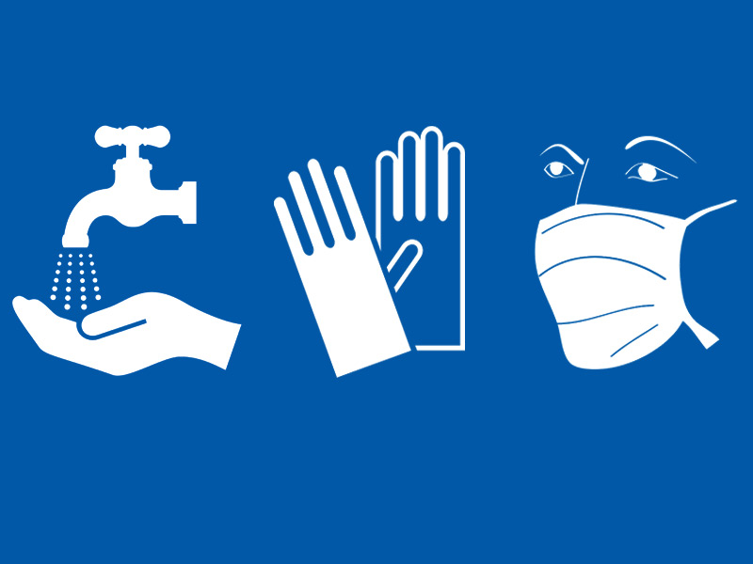
Universal Precautions
for Trauma-Informed Care
How do you ‘Glove Up?’
How do you reduce possibilities of triggering and re-traumatizing?
Notes:
TI Teaching: Universal Precautions
Level: Beginner/Intermediate/Clinical
Discussion: So what do we do? Do I have to ‘walk on eggshells’ now to avoid re-traumatization? No!
Let’s compare the universal precautions we’re about to discuss to the medical field… Doctors, nurses, and other medical professionals use preventative measurements to contain potentially hazardous or infectious materials/fluids. This keeps everyone as safe as possible and is just part of being a medical professional and patient.
Taking universal precautions approach, you would be treating all fluid in the same manner without first determining the level of hazard
So how do I ‘glove up’?
Trauma Informed care is also a universal precaution – assume that all individual have a history of trauma -glove up metaphorically – change interaction style, policies, procedures, in order to reduce the possibility of triggering or re-traumatizing others
This is why we have models of the 6 Key Principles of a Trauma-informed Approach AND the 4 R’s to guide your work.
Ways to “glove up”
Take care to reduce the possibilities of triggering and traumatization
Establish and maintain professional relationships that are safe – boundaries, clear communication, honesty and empathy
Understand and recognize potential trauma responses – triggers and trauma reminders come in all forms
Sources
Sourced from: Williams-Hecksel, C., Miller, D., & Fritz, T. (n.d.). Building Trauma-Informed Learning Environments.
Bloom, S. L., & Farragher, B. (2013). Restoring sanctuary: A new operating system for trauma-informed systems of care. New York, NY: Oxford University Press.
Burke Harris, N. (2014, September). How childhood trauma affects health across a lifetime [Video file]. Retrieved from https://www.ted.com/talks/nadine_burke_harris_how_childhood_trauma_affects_health_across_a_lifetime

Slide 16
Key Principles of a Trauma-informed Approach
Cultural, Historical and Gender Issues
Safety
Trustworthiness and Transparency
Peer Support
Collaboration and Mutuality
Empowerment, Voice and Choice
Notes:
TI Teaching: Key Principles Applied
Level: Beginner/Intermediate/Clinical
Identify some examples​
These are guiding principles for trauma informed practice. Let’s explore them a bit. ​
How do you establish physical safety for students? ​
How do you establish psychological safety for students? ​
What contributes to trustworthiness? ​
How can you be transparent? ​
What do you do to foster positive peer relationships? Especially in the age of Zoom? ​
How can peer support and mutual self-help be integrated into your teaching? ​
What are the ways that you collaborate with students? How can you be explicit about this? ​
What does mutuality mean in the classroom? ​
How do students have voice and what do you do to foster agency. The power differential is real, even if you think it is not. ​
What do you think are best practices to overcome the impact of the power differentials? ​
What are the considerations related to cultural, historical and gender issues with your course content? ​
What are the considerations for your relationships with students, their relationships with each other? ​
How do you consider implicit bias and its impact in the classroom? How will you address microaggressions in the classroom? ​
How can you create safety around issues that may be difficult for students?
Sources
SAMHSA. (July 2014). Concept of Trauma and Guidance for a Trauma-Informed Approach. SAMHSA’s Trauma and Justice Strategic Initiative. https://ncsacw.acf.hhs.gov/userfiles/files/SAMHSA_Trauma.pdf

Slide 17
Discussion
Notes:
TI Teaching: Discussion and Questions
Level: Beginner/Intermediate/Clinical
Discussion
What are ways you can incorporate trauma-informed teaching in your classroom?
What are ways you can incorporate trauma-informed teaching in office hours?
What are other ways to be more trauma-informed in your role?
Can you think of instances you may have responded differently knowing what you know now?
What concerns do you still have about implementing Ti into your practice?

Slide 18
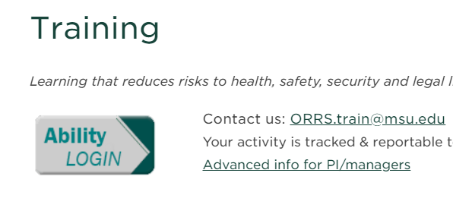
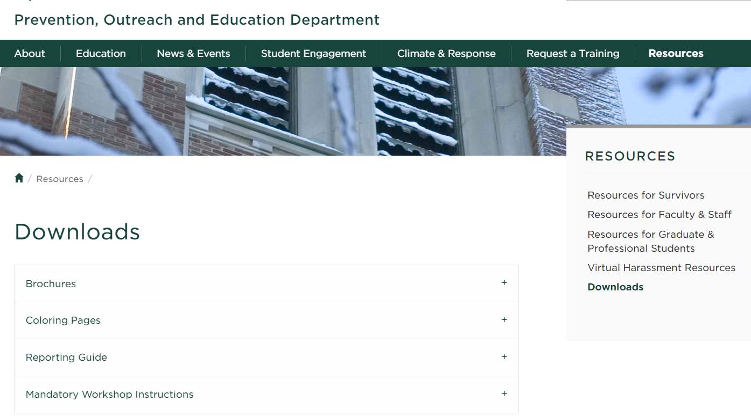
Responding to Disclosures
Training and resources
Notes:
Responding to Disclosures: Intro/Review
Level: Beginner/Intermediate/Clinical
Discussion
As employees, volunteers, graduate students, students, we as a community take the Relationship Violence and Sexual Misconduct Training (RVSM). You may recognize the login for the training module on the right.
For refreshers, The Prevention, Outreach and Education Department has many resources on their website. https://poe.msu.edu/index.html https://poe.msu.edu/resources/downloads.html

Slide 19
Responding to a Disclosure
Address and Establish Safety
“Thank you for telling me”
A private place to talk
Avoid physical touch
Don’t push the conversation
“I believe you”
Communicate your duty to report
Show your Support
Earlier rather than later!
Don’t Overstep
Refrain from giving advice
Remember your role
With a trauma-informed approach
Notes:
Responding to Disclosure: TI Approach
Level: Beginner/Intermediate/Clinical
Discussion
Communicate your duty to report (Prevention, Outreach, and Education Department, 2021)
Earlier rather than later! (Prevention, Outreach, and Education Department, 2021)
Address and Establish Safety (Muhammad, n.d.).
A private place to talk
Avoid physical touch
Don’t push the conversation (Muhammad, n.d.).
Don’t Overstep (Prevention, Outreach, and Education Department, 2021)
Refrain from giving advice
Remember your role (Prevention, Outreach, and Education Department, 2021)
Show your Support (Prevention, Outreach, and Education Department, 2021)
“I believe you”
“Thank you for telling me”
Resources
Syllabus language to notify students you are a mandatory reporter: https://civilrights.msu.edu/resources/information-for-mandatory-reporters.html
Title IX Policy: https://civilrights.msu.edu/policies/relationship-violence-and-sexual-misconduct-and-title-ix-policy.html#reporting
SUPER helpful handout: Prevention, Outreach, and Education Department. (2021, Feb 11). RVSM Reporting Guide. https://poe.msu.edu/resources/Reporting%20Guide%202021.pdf
Sources
Muhammad, R. (n.d.). LEAD - Relationship Violence & Sexual Misconduct Policy (RVSM). #iteachmsu. Michigan State University. https://iteach.msu.edu/iteachmsu/groups/iteachmsu/stories/245
Prevention, Outreach, and Education Department. (2021, Feb 11). RVSM Reporting Guide. https://poe.msu.edu/resources/Reporting%20Guide%202021.pdf

Slide 20
Responding to a Disclosure
Employee responsibility
Employees MUST report prohibited conduct if observed or learned about
Reports may be submitted in person, by mail, by telephone, or by electronic mail
MSU Police Department
Office of Institutional Equity
Title IX Coordinator
1120 Red Cedar Road
East Lansing, MI 48824
(517) 355-2221
Emergencies: 911
408 W. Circle Dr., Suite 5, Olds Hall
East Lansing, MI 48824
(517) 353-3922
oie@msu.edu
Nicole Schmidtke, JD
Office for Civil Rights and Title IX Education and Compliance
408 W. Circle Dr. Suite 5, Olds Hall
East Lansing, MI 48824
(517) 353-3922
Notes:
Responding to Disclosure: Compliance
Level: Beginner/Intermediate/Clinical
Discussion
University faculty, staff, academic staff, and volunteers, unless specifically exempted under the Reporting Protocols for Relationship Violence and Sexual Misconduct, must promptly report incidents of prohibited conduct that they observe or learn about in their professional capacity or in the context of their work and that involve a member of the University community (student, employee, MSU Health Care patient, or other individuals) or which occurred at a University-sponsored event or on University property. (Michigan State University, 2021)
Sources
Michigan State University. (2021, August 24). Relationship Violence and Sexual Misconduct and Title IX Policy. Office for Civil Rights and Title IX Education and Compliance. https://civilrights.msu.edu/policies/relationship-violence-and-sexual-misconduct-and-title-ix-policy.html#consent

