Slide 1
Stress Response
Notes:
Before we can discuss traumatic stress, one needs to understand the natural Fight Flight and Freeze response.

Slide 2



Stress Response
Fight
Flight
Freeze
Notes:
Stress Response: Definition
Level: Beginning/Intermediate/Clinical
Discussion
Stress Response/ Fight-Flight-Freeze: The body’s natural response to threat/danger, characterized by stress hormones readying the body to either fight (aggression), flee (escape), or freeze (inaction). This response tends to be overactive in individuals who have experienced trauma (The Institute on Trauma and Trauma-Informed Care, 2021)
Sources:
The Institute on Trauma and Trauma-Informed Care. (2021, October). Trauma-Informed Organizational Change Manual. University at Buffalo School of Social Work. http://socialwork.buffalo.edu/social-research/institutes-centers/institute-on-trauma-and-trauma-informed-care/Trauma-Informed-Organizational-Change-Manual0.html

Slide 3

https://www.pexels.com/photo/
Notes:
Stress Response: Example 1A
Level: Beginner
Narration: Now imagine that you are taking a nice walk through a park near your home. You’ve done this many times, and it’s peaceful. A place to think, listen to nature. As you are walking, you look down and see movement to your right.
Sourced from: Kelley Blanck, LMSW “Understanding Trauma” Presentation

Slide 4
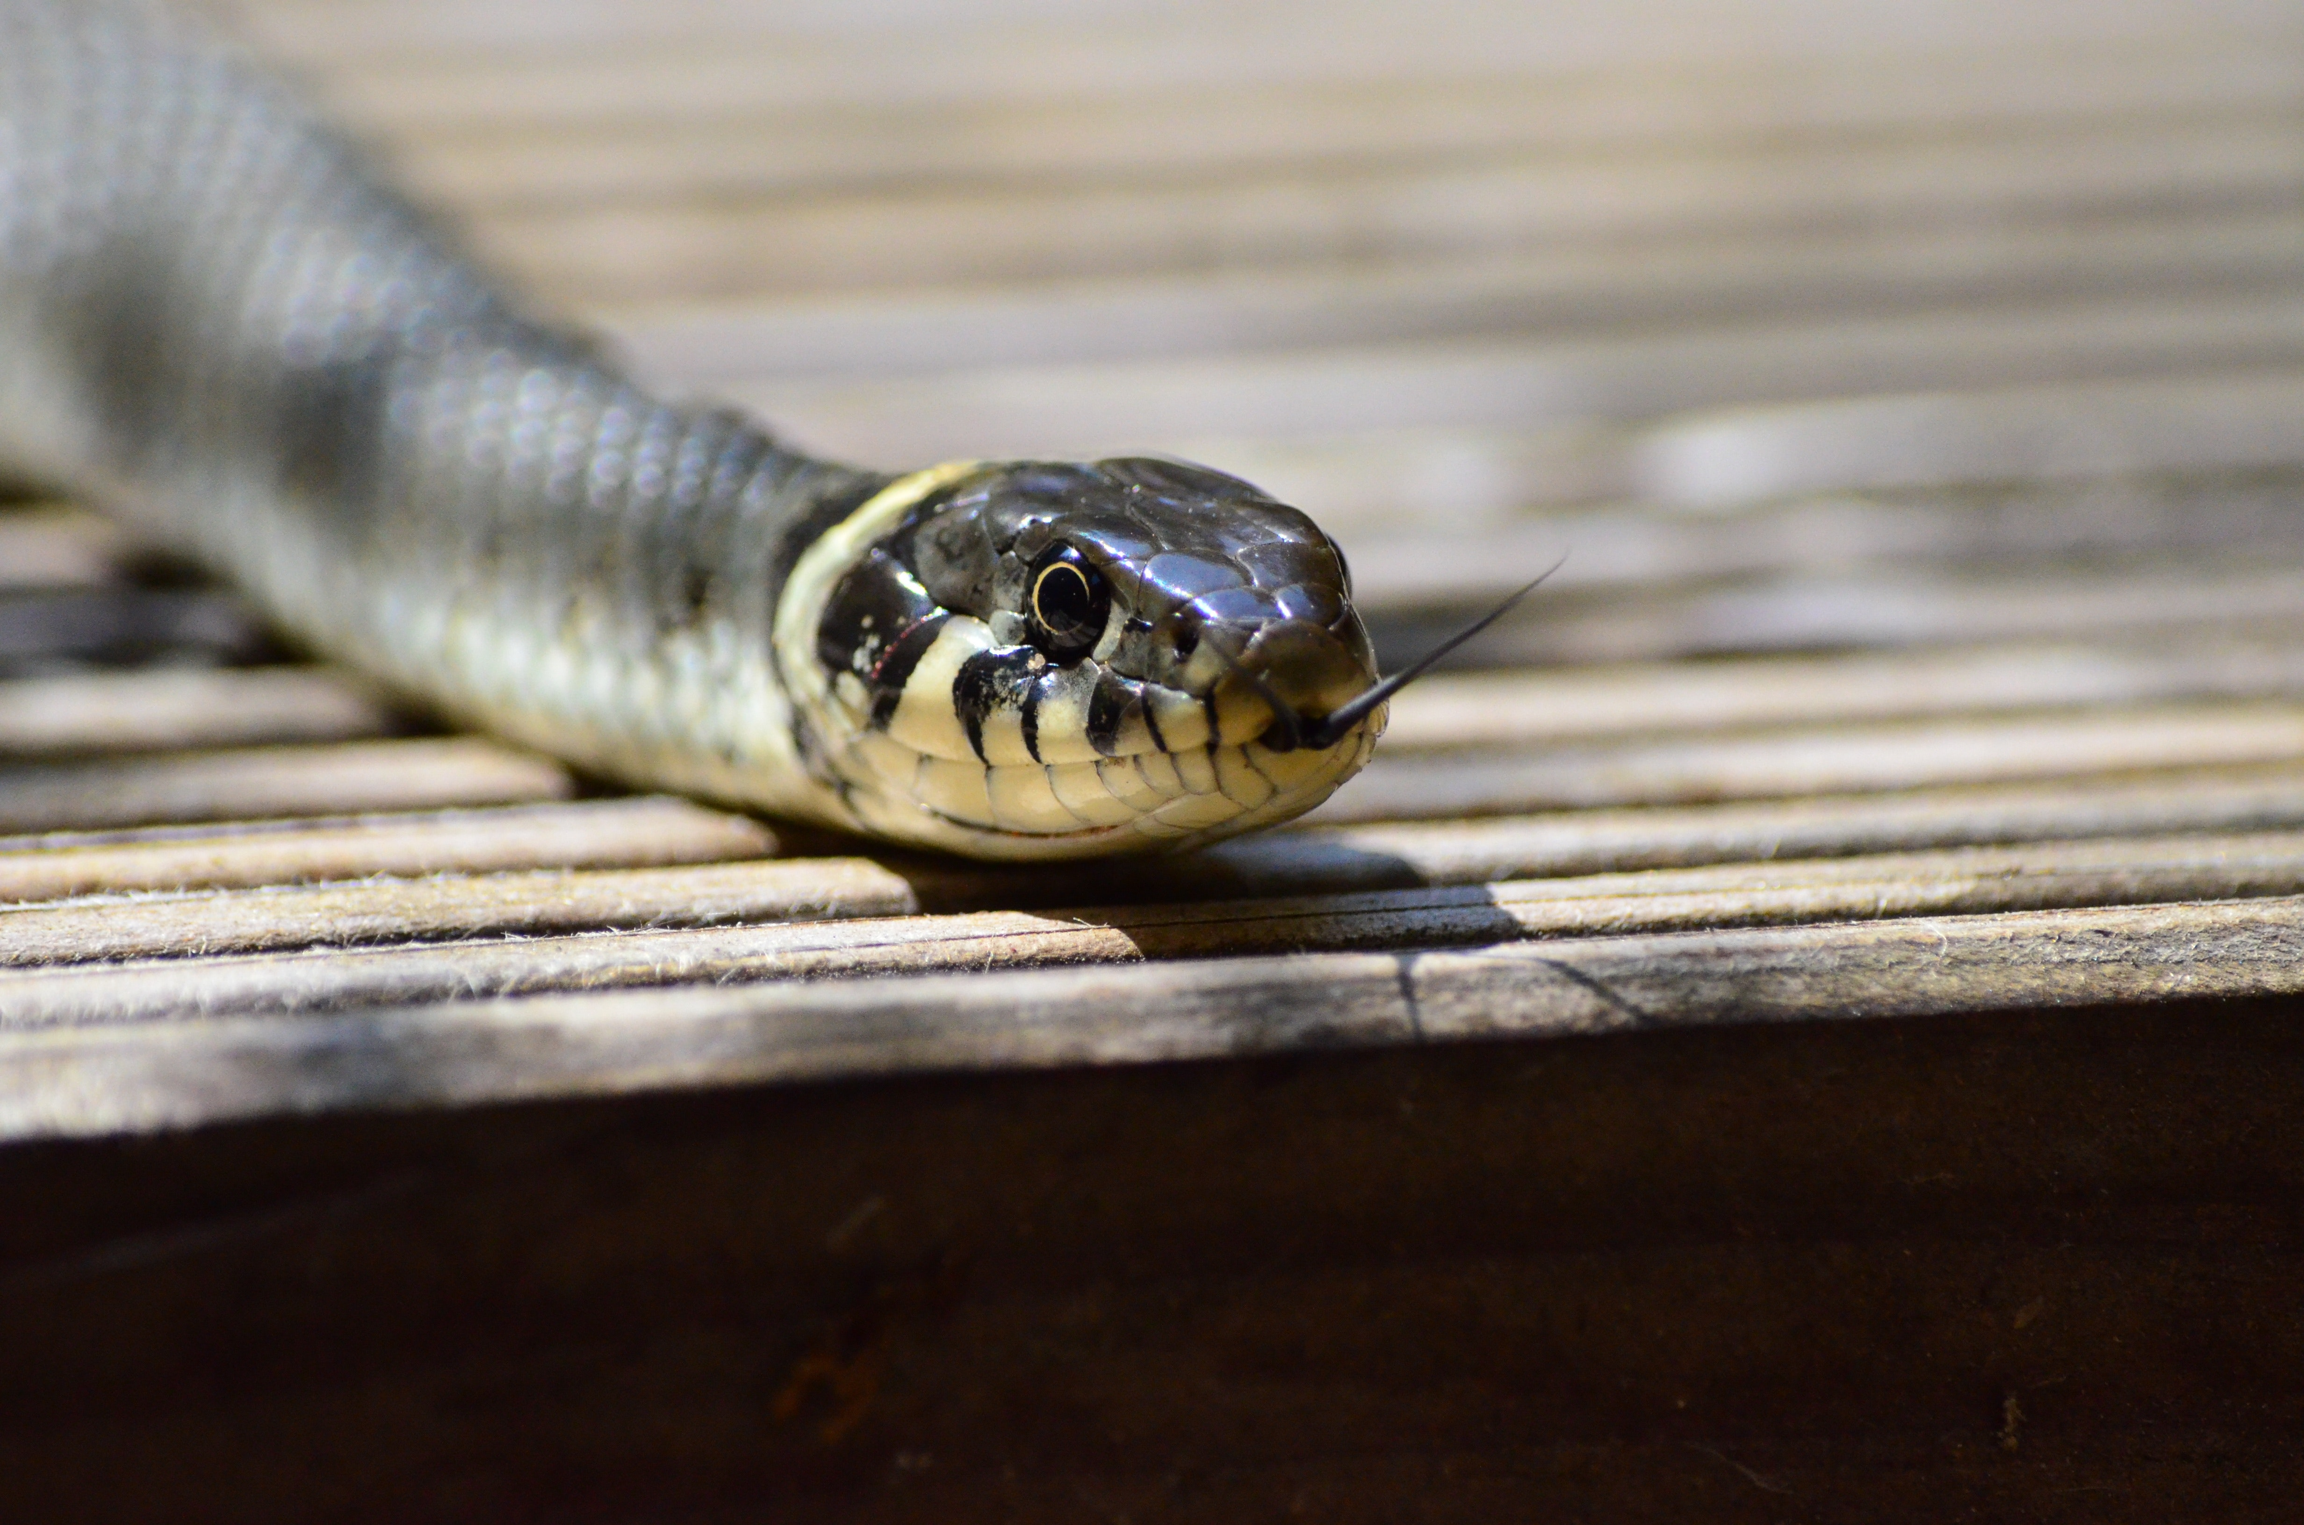
https://www.pexels.com/photo/white-and-gray-snake-on-brown-wooden-table-top-53964/
Notes:
Stress Response: Example 1B
Level: Beginner
Narration: Suddenly, there is a huge snake slithering near your foot! What do you do? What happens to your heart, your breathing, your vision?
Sourced from: Kelley Blanck, LMSW “Understanding Trauma” Presentation

Slide 5

https://www.pexels.com/photo/light-landscape-nature-forest-117843/
Notes:
Stress Response: Example 1C
Level: Beginner
Narration: The next time you take a walk in that woods, you’re going to watch the ground a lot more now. And what about if you see a stick that looks like a snake? Even if you’d been through that mark many times before without seeing a snake, seeing a snake once changes your perception of the park, and maybe makes you expect danger there. Our brains are wired this way to generalize the direction of looking out for danger so that we can protect ourselves.
Optional Discussion:
Have you ever had an experience that you fought, flighted, or froze? Did it feel silly or warranted? Do you wish your body would have responded differently?
Sourced from: Kelley Blanck, LMSW “Understanding Trauma” Presentation

Slide 6
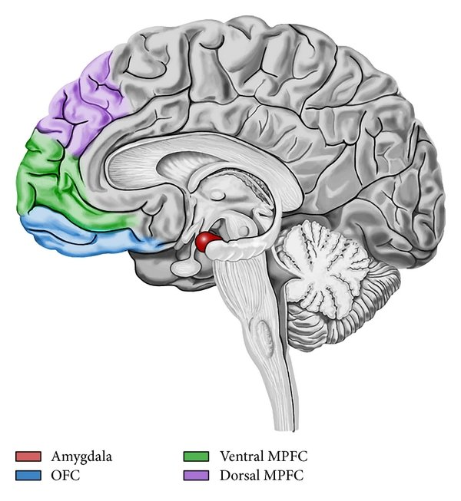
Stress Response
Inside the mind
Prefrontal Cortex
Learning, thinking ahead, executive functioning
Amygdala
"Alarm System"
(Compare et al., 2014)
Notes:
Stress Response: Brain
Level: Beginner/Intermediate/Clinical
Activity: Have participants create a hand diagram of the brain. For video instruction: https://www.youtube.com/watch?v=gm9CIJ74Oxw
"Take one of your hands with palm up and fingers together.
Tuck your thumb into your palm. Your thumb represents the Amygdala of the brain, which interprets whether incoming sensory information is a threat, AKA the "alarm system". This part of the brain will experience Fight/Flight/Freeze. This is one of the oldest parts of the brain, designed to help humans survive natural threats
Now let your fingers bend to cover your thumb. Your hand should look like a fist with the thumb tucked inside. Your 4 fingers represent the prefrontal cortex, which is responsible for executive functioning, impulse control, learning, thinking ahead, etc. This is also the part of the brain that eventually lets us know that there is no longer a threat so that the amygdala can cease sending the alarm. Traumatic experiences damage he prefrontal cortex, which weakens the its ability to call off the "alarm system". (The Institute on Trauma and Trauma-Informed Care, 2021)
Discussion:
Ideally, The prefrontal cortex is “online,” and therefore the individual is capable of executive functioning, impulse control, reasoning and logic.
When the prefrontal cortex does not function appropriately, The amygdala rapidly fires in order to activate the survival response— similar to sounding an alarm. As a result, the amygdala firing causes the lid to “flip”. The prefrontal cortex is now “offline,” as the amygdala becomes the body’s driving force in order to react to the threat (either fight, run or freeze). (The Institute on Trauma and Trauma-Informed Care, 2021)
Question for participants: When you remove or damage the function of the prefrontal cortex (the 4 fingers), what is left? What may that response look like?
CONCLUSION (Must use)
Faced with chronic ongoing exposure to traumatic stress young peoples fear response becomes chronically activated. This fight flight freeze response becomes generalized to experiences that may not present threat. When people are in the fight flight freeze mode and the fear center of their brain is activated, the prefrontal cortex goes offline. The prefrontal cortex, is where executive functioning happens.
Executive functioning skills includes
Paying attention
Organizing, planning, and prioritizing
Starting tasks and staying focused on them to completion
Understanding different points of view
Regulating emotions
Self-monitoring (keeping track of what you’re doing)
Further Learning:
Dr. Rebecca Campbell from MSU
National Institute of Justice. (2019, Aug 29). The Neurobiology of Sexual Assault: Implications for First Responders. Youtube. https://www.youtube.com/watch?v=QuirVpIhl0g&t=60s
Helpful Handout: National Institute for the Clinical Application of Behavioral Medicine (n.d.) What Happens in the Brain During Trauma? [Infographic]. https://www.nicabm.com/what-happens-in-the-brain-during-trauma-infographic/?fbclid=IwAR1E6D6zY5v0cbJuVO2K5IfEtwMt9dSq415co8vZH0RustyzQnWQifLmq4g
Sources
Compare, Angelo & Zarbo, Cristina & Shonin, Dr Edo & Van Gordon, William & Marconi, Chiara. (2014). Compare, A., Zarbo, C., Shonin, E., Van Gordon, W., & Marconi, C. (2014). Emotional regulation and depression: A potential mediator between heart and mind. Cardiovascular Psychiatry and Neurology, 2014, Article ID 324374, DOI 10.1155/2014/324374.. Cardiovascular psychiatry and neurology. 2014. 324374. 10.1155/2014/324374.
The Institute on Trauma and Trauma-Informed Care. (2021, October). TRAUMA-INFORMED ORGANIZATIONAL CHANGE MANUAL. University at Buffalo School of Social Work

